Slide 1
Wafermap Analysis Report
Generated on 2026-02-23 10:28

Slide 2
Gage R&R Report - Agenda
# | Group | Parameters | Pages | Slides
1 | 📋 Agenda | - | Page 2 | 1
2 | 📖 Calculation Parameters | - | Page 3 | 1
3 | DC_SHORT | 5 | Page 4-8 | 5
4 | Dc_Debug | 1 | Page 9-13 | 5
5 | Dc_Pwr | 10 | Page 14-18 | 5
6 | 📊 Stitched - Pixel Mean | - | Page 19 | 1
7 | 📍 Stitched - Pixel Position based | 5 dies | Page 20-25 | 6
Total: 7 Groups | 16 Parameters | 24 Slides

Slide 3
Gage R&R - Calculation Parameters
BASIC STATISTICAL VALUES
Mean (Mittelwert):
Average of all measurements across all files and dies.
Mean = Σ(xi) / n
Std Dev (Standardabweichung):
Measure of dispersion around the mean.
σ = √[Σ(xi - Mean)² / n]
Range (Spannweite):
Difference between maximum and minimum.
Range = Max - Min
LSL / USL (Spec Limits):
Statistical limits (k = sigma factor).
LSL = Mean - kσ | USL = Mean + kσ
GAGE R&R COMPONENTS
Repeatability (EV):
Variation within measurements of one file (equipment).
EV = Mean(σ within each file)
Reproducibility (AV):
Variation between files/operators/trials.
AV = σ(file means)
GRR Total:
Combined measurement system variation.
GRR = R̄ / d₂ (Range Method)
ASSESSMENT METRICS
%GRR (Prozent GRR):
GRR as percentage of total variation or tolerance.
%GRR = (GRR / TV) × 100 or (GRR / Tolerance) × 100
ndc (Using Total Variation):
Number of distinct categories the system can distinguish.
ndc = 1.41 × (TV / GRR)
ASSESSMENT CRITERIA (AIAG MSA)
🟢 EXCELLENT: %GRR < 10%
Measurement system is acceptable.
🟡 ACCEPTABLE: 10% ≤ %GRR < 30%
May be acceptable depending on application.
🔴 UNACCEPTABLE: %GRR ≥ 30%
Measurement system must be improved.
ndc ≥ 5: Good measurement system
Can distinguish ≥ 5 distinct categories.
INTERPRETATION
• High Repeatability → Equipment/method problem
• High Reproducibility → Operator/process/time problem
• ndc should be ≥ 5 for a good measurement system
• Values outside LSL/USL indicate outliers

Slide 4
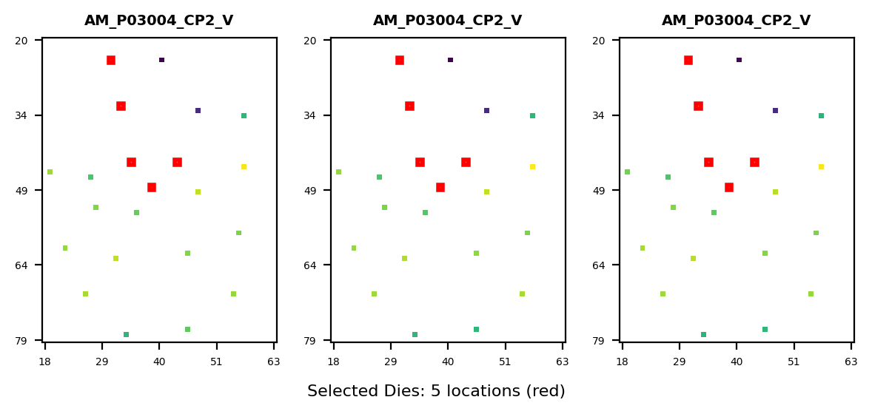
Gage R&R Study Overview - DC_SHORT
Study Configuration
• Files/Trials: 3 • Dies/Parts: 5 • Parameters: 18
Parameters Analyzed:
1. 10020001: LOW_VDD10_FV0P1_X VDD10 22.g404hc <
2. 10020002: LOW_VDD18IO_FV0P1_X VDD18IO 22.a402
3. 10020003: LOW_AVDD18_FV0P1_X AVDD18 22.c403 <
4. 10020004: LOW_VQPSEFUSE_FV0P1_X VQPS_EFUSE 22
5. 10020005: LOW_AVEE_FV0P1_X AVEE 20.w402 <> DC
Overall Result: FAIL
✗ Gage R&R FAILED for 5 parameter(s) due to excessive measurement variation (>30%). Failing parameters: DC_SHORT_LOW_VQPSEFUSE_FV, DC_SHORT_LOW_VDD10_FV0P1_, DC_SHORT_LOW_AVDD18_FV0P1 (+2 more) Recommendation: Review measurement equipment, operator training, or test methodology.
Assessment: 0 Excellent | 0 Acceptable | 5 Unacceptable

Slide 5
Gage R&R - Calculation Parameters (Formulas)
BASIC STATISTICAL VALUES
Mean (Mittelwert):
Average of all measurements across all files and dies.
Mean = Σ(xi) / n
Std Dev (Standardabweichung):
Measure of dispersion around the mean.
σ = √[Σ(xi - Mean)² / n]
Range (Spannweite):
Difference between maximum and minimum.
Range = Max - Min
LSL / USL (Spec Limits):
Statistical limits (k = sigma factor).
LSL = Mean - kσ | USL = Mean + kσ
GAGE R&R COMPONENTS
Repeatability (EV):
Variation within measurements of one file (equipment).
EV = Mean(σ within each file)
Reproducibility (AV):
Variation between files/operators/trials.
AV = σ(file means)
GRR Total:
Combined measurement system variation.
GRR = R̄ / d₂ (Range Method)
Part Variation (PV):
True variation between parts/dies.
PV = σ(part means)
Total Variation (TV):
Total observed variation.
TV = √(PV² + GRR²)
ASSESSMENT METRICS
%GRR (Prozent GRR):
GRR as percentage of total variation or tolerance.
%GRR = (GRR / TV) × 100 or (GRR / Tolerance) × 100
ndc (Using Part Variation):
Number of distinct categories the system can distinguish.
ndc = 1.41 × (PV / GRR)
ASSESSMENT CRITERIA (AIAG MSA)
🟢 EXCELLENT: %GRR < 10%
Measurement system is acceptable.
🟡 ACCEPTABLE: 10% ≤ %GRR < 30%
May be acceptable depending on application.
🔴 UNACCEPTABLE: %GRR ≥ 30%
Measurement system must be improved.
ndc ≥ 5: Good measurement system
Can distinguish ≥ 5 distinct categories.
INTERPRETATION
• High Repeatability → Equipment/method problem
• High Reproducibility → Operator/process/time problem
• ndc should be ≥ 5 for a good measurement system
• Values outside LSL/USL indicate outliers

Slide 6
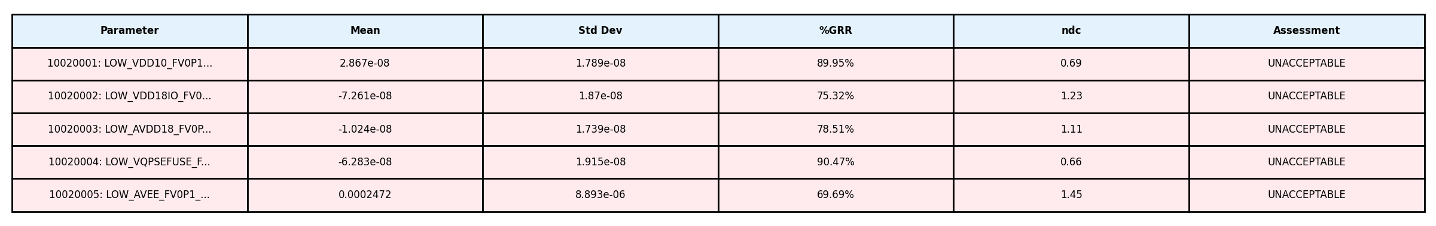
Gage R&R Analysis Summary - DC_SHORT
Study Information: • Files (Operators/Trials): 3 • Dies (Parts): 5 • Parameters Analyzed: 18

Slide 7
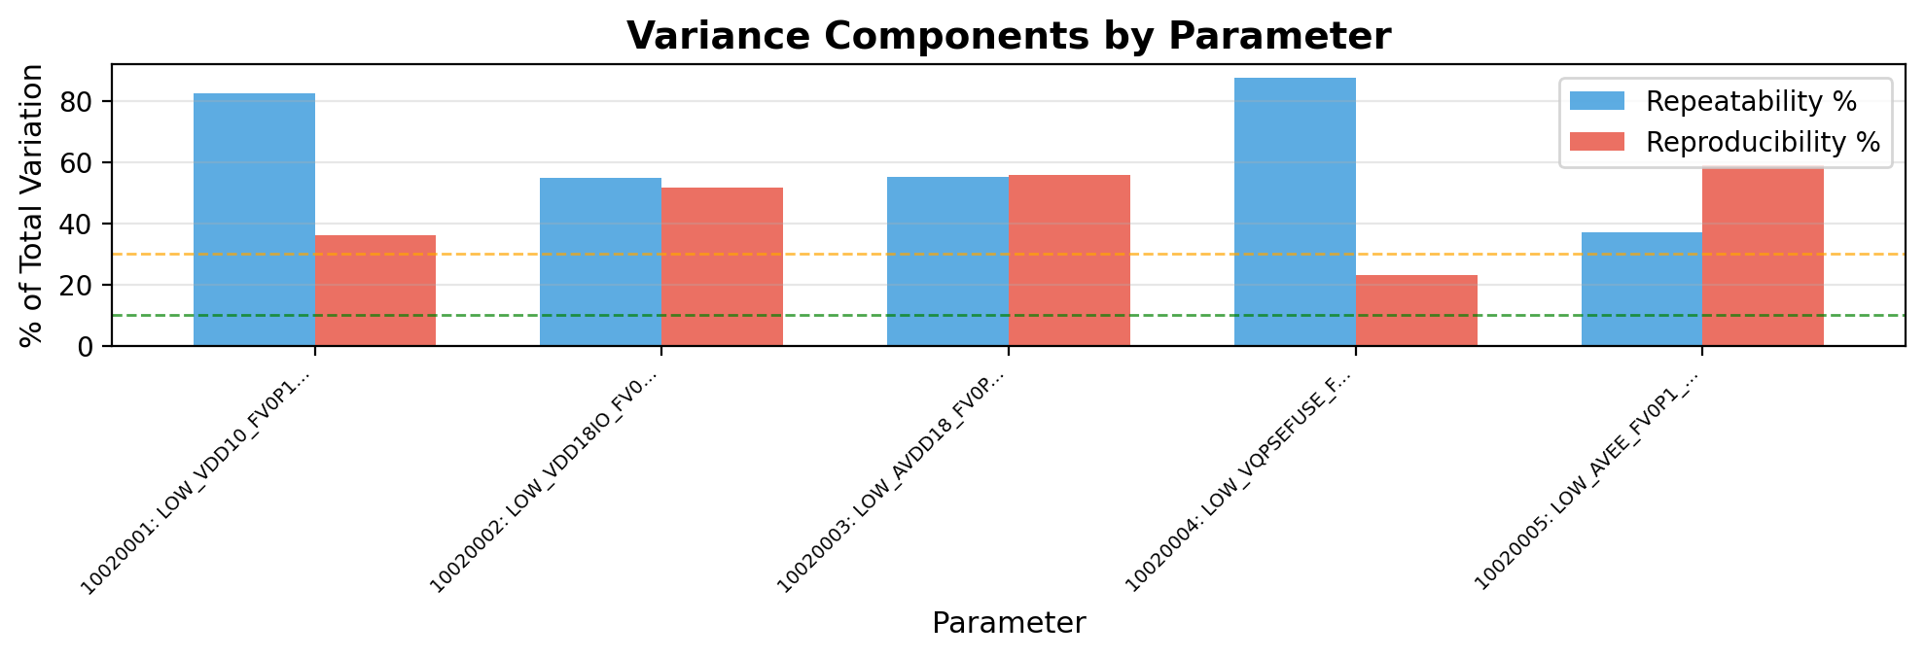
Gage R&R - Variance Components - DC_SHORT
Interpretation:
• Repeatability (blue): Variation when same operator measures same part multiple times (equipment variation)
• Reproducibility (red): Variation between different operators/trials measuring same part (operator variation)
→ Analysis: Repeatability (63.4%) > Reproducibility (45.1%). Equipment/method variation is dominant. Consider equipment calibration or method refinement.

Slide 8
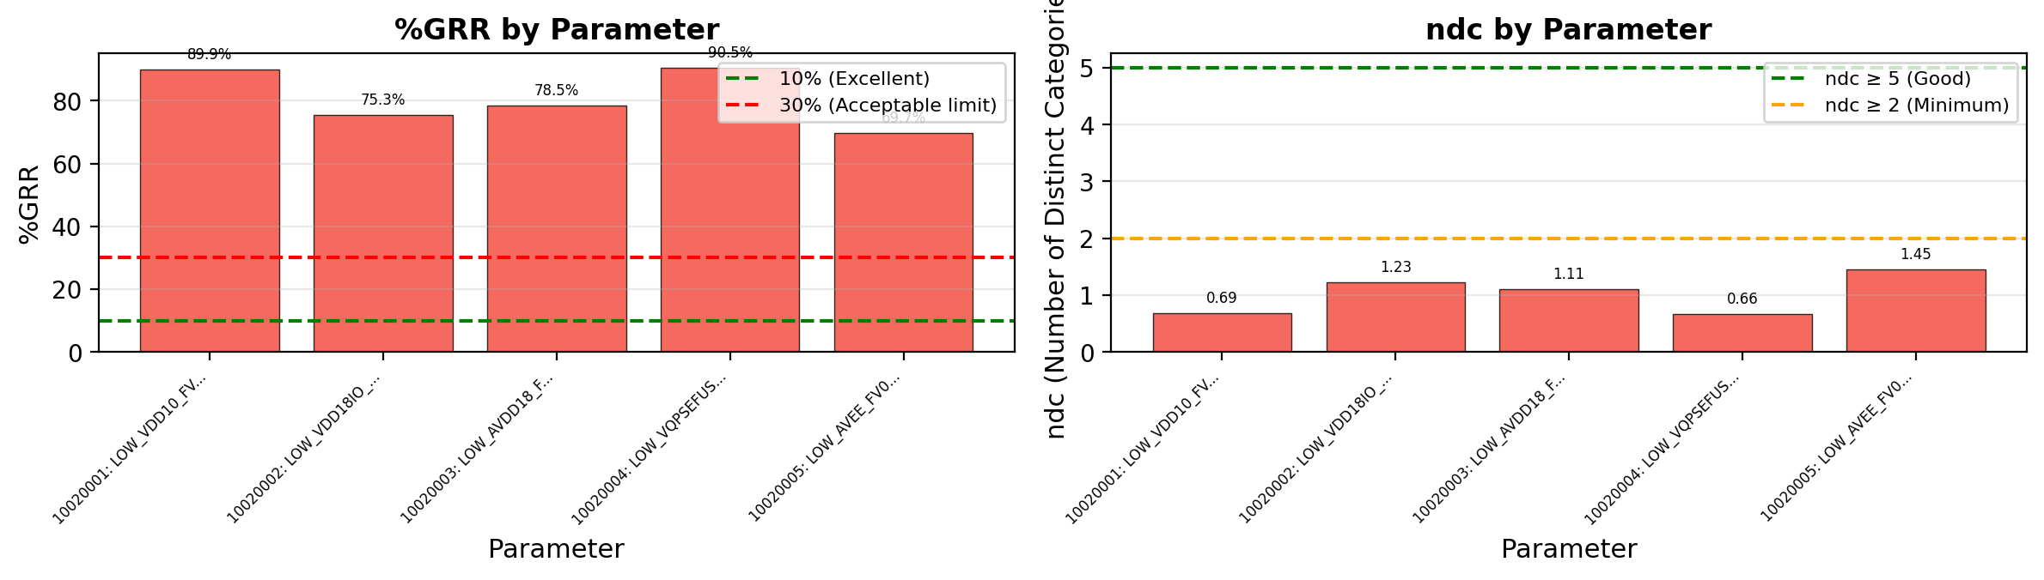
Gage R&R - %GRR and ndc - DC_SHORT
Acceptance Criteria & Interpretation:
• %GRR < 10%: EXCELLENT - Measurement system is excellent for this application
• %GRR 10-30%: ACCEPTABLE - May be acceptable depending on application criticality
• %GRR > 30%: UNACCEPTABLE - Measurement system needs improvement
• ndc (Number of Distinct Categories): Indicates how many distinct categories the measurement can reliably distinguish. ndc ≥ 5 is recommended.
⚠ Warning: 5 parameter(s) have ndc < 5: DC_SHORT_LOW_VDD10_F, DC_SHORT_LOW_VDD18IO, DC_SHORT_LOW_AVDD18_

Slide 9
Gage R&R Study Overview - Dc_Debug
Study Configuration
• Files/Trials: 3 • Dies/Parts: 5 • Parameters: 18
Parameters Analyzed:
1. 30025001: TESTTIME_TIMESTAMP_X -1 <> DC_DEBU
Overall Result: FAIL
✗ Gage R&R FAILED for 1 parameter(s) due to excessive measurement variation (>30%). Failing parameters: DC_DEBUG_TESTTIME_TIMESTA Recommendation: Review measurement equipment, operator training, or test methodology.
Assessment: 0 Excellent | 0 Acceptable | 1 Unacceptable

Slide 10
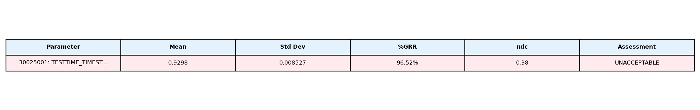
Gage R&R Analysis Summary - Dc_Debug
Study Information: • Files (Operators/Trials): 3 • Dies (Parts): 5 • Parameters Analyzed: 18

Slide 11
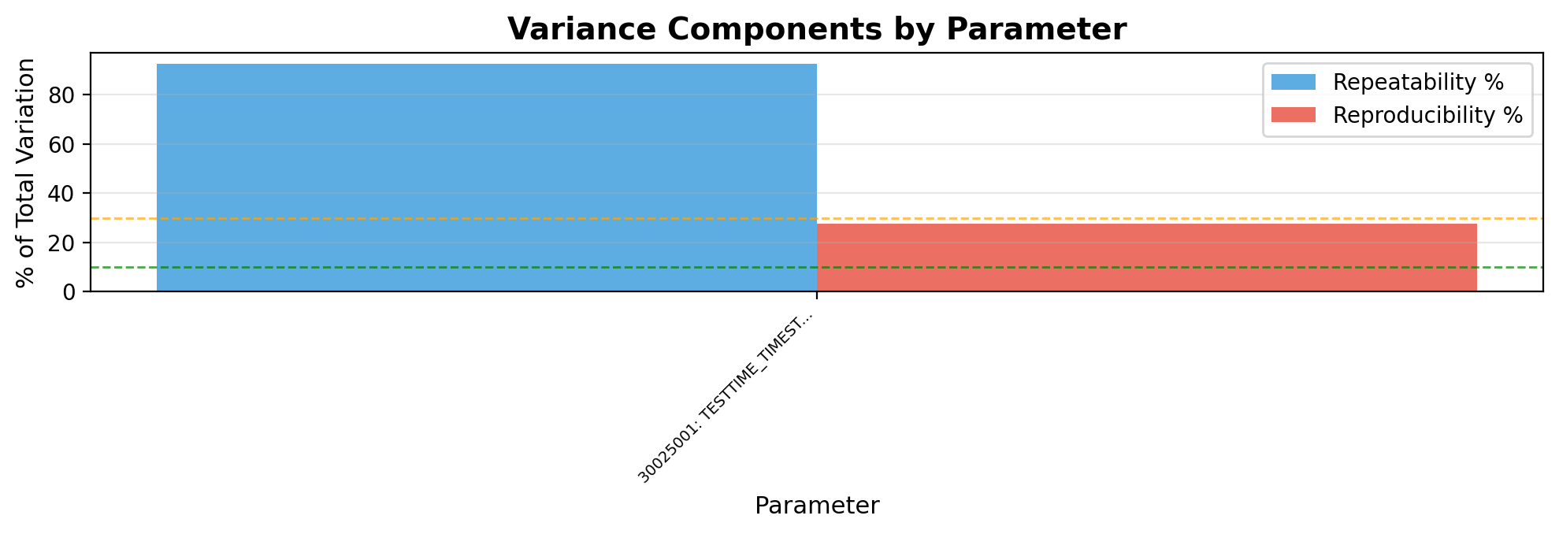
Gage R&R - Variance Components - Dc_Debug
Interpretation:
• Repeatability (blue): Variation when same operator measures same part multiple times (equipment variation)
• Reproducibility (red): Variation between different operators/trials measuring same part (operator variation)
→ Analysis: Repeatability (92.5%) > Reproducibility (27.5%). Equipment/method variation is dominant. Consider equipment calibration or method refinement.

Slide 12
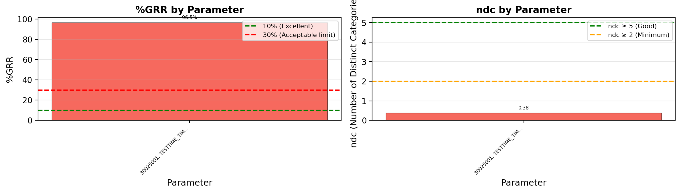
Gage R&R - %GRR and ndc - Dc_Debug
Acceptance Criteria & Interpretation:
• %GRR < 10%: EXCELLENT - Measurement system is excellent for this application
• %GRR 10-30%: ACCEPTABLE - May be acceptable depending on application criticality
• %GRR > 30%: UNACCEPTABLE - Measurement system needs improvement
• ndc (Number of Distinct Categories): Indicates how many distinct categories the measurement can reliably distinguish. ndc ≥ 5 is recommended.
⚠ Warning: 1 parameter(s) have ndc < 5: DC_DEBUG_TESTTIME_TI

Slide 13
Gage R&R Study Overview - Dc_Pwr
Study Configuration
• Files/Trials: 3 • Dies/Parts: 5 • Parameters: 18
Parameters Analyzed:
1. 11405006: STATIC_VDD10_VNOM_X VDD10 22.g404hc
2. 11405007: STATIC_VDD18IO_VNOM_X VDD18IO 22.a4
3. 11405008: STATIC_AVDD18_VNOM_X AVDD18 22.c403
4. 11405009: STATIC_AVEE_VNOM_X AVEE 20.w402 <>
5. 11405010: STATIC_TotalPower_VNOM_X TotalPower
6. 11405011: STATIC_VDD10_VMIN_X VDD10 22.g404hc
7. 11405012: STATIC_VDD18IO_VMIN_X VDD18IO 22.a4
8. 11405013: STATIC_AVDD18_VMIN_X AVDD18 22.c403
... +2 more
Overall Result: FAIL
✗ Gage R&R FAILED for 6 parameter(s) due to excessive measurement variation (>30%). Failing parameters: DC_PWR_STATIC_AVEE_VMIN_X, DC_PWR_STATIC_AVDD18_VMIN, DC_PWR_STATIC_AVDD18_VNOM (+3 more) Recommendation: Review measurement equipment, operator training, or test methodology.
Assessment: 0 Excellent | 4 Acceptable | 6 Unacceptable

Slide 14
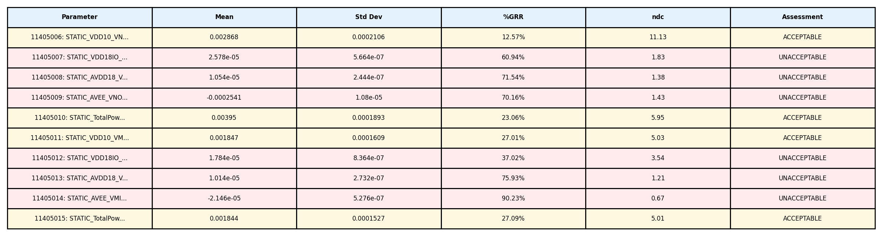
Gage R&R Analysis Summary - Dc_Pwr
Study Information: • Files (Operators/Trials): 3 • Dies (Parts): 5 • Parameters Analyzed: 18

Slide 15
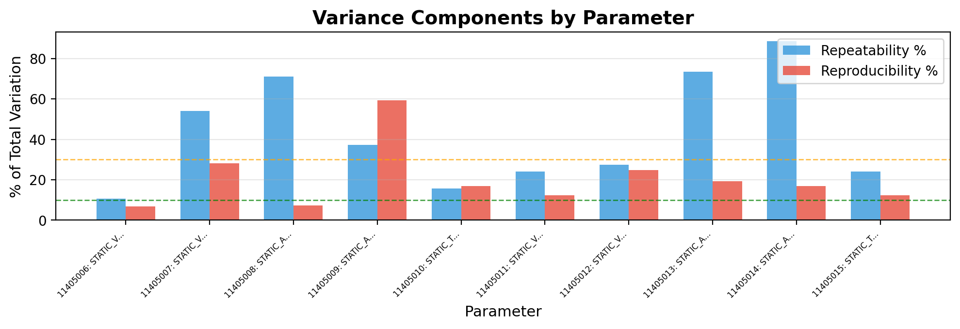
Gage R&R - Variance Components - Dc_Pwr
Interpretation:
• Repeatability (blue): Variation when same operator measures same part multiple times (equipment variation)
• Reproducibility (red): Variation between different operators/trials measuring same part (operator variation)
→ Analysis: Repeatability (42.7%) > Reproducibility (20.4%). Equipment/method variation is dominant. Consider equipment calibration or method refinement.

Slide 16
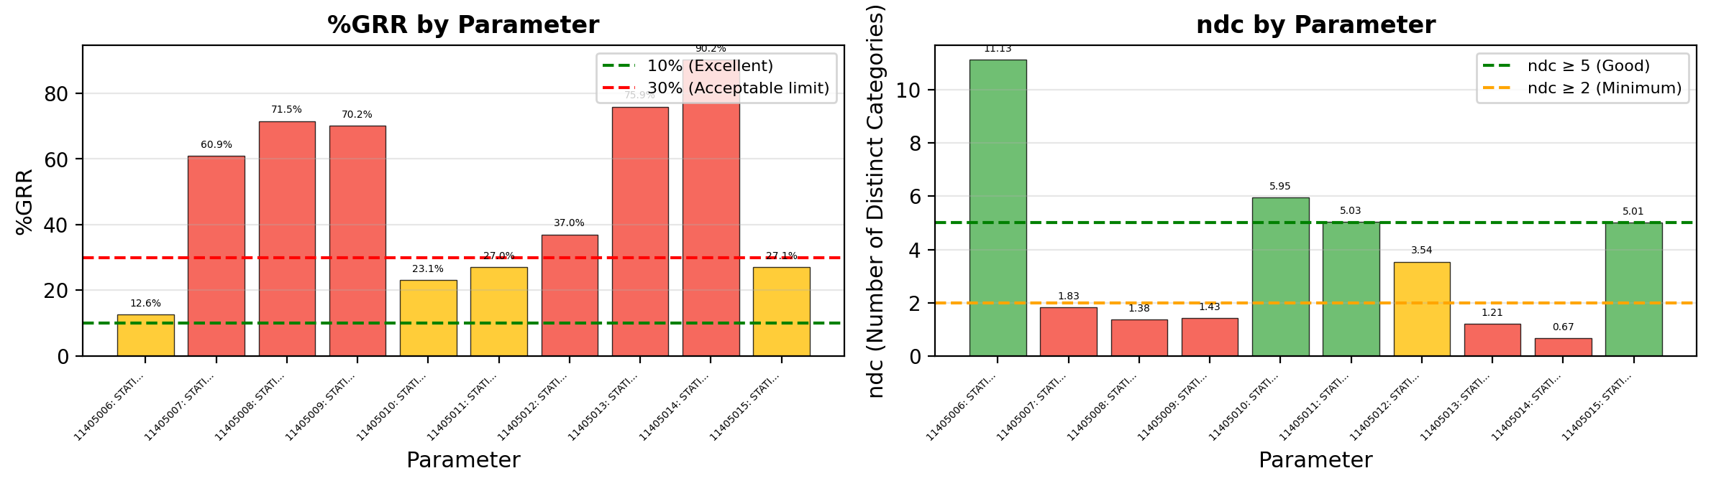
Gage R&R - %GRR and ndc - Dc_Pwr
Acceptance Criteria & Interpretation:
• %GRR < 10%: EXCELLENT - Measurement system is excellent for this application
• %GRR 10-30%: ACCEPTABLE - May be acceptable depending on application criticality
• %GRR > 30%: UNACCEPTABLE - Measurement system needs improvement
• ndc (Number of Distinct Categories): Indicates how many distinct categories the measurement can reliably distinguish. ndc ≥ 5 is recommended.
⚠ Warning: 6 parameter(s) have ndc < 5: DC_PWR_STATIC_VDD18I, DC_PWR_STATIC_AVDD18, DC_PWR_STATIC_AVEE_V

Slide 17
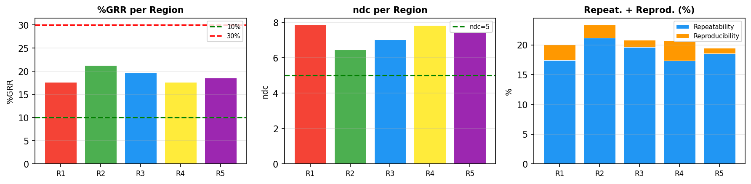
PLM Pixel Analysis - Stitched - Die (31,24)
Region | Position | Size | %GRR | ndc | Repeat.% | Reprod.% | Result
R1 | (129,280)->(154,305) | 25x25 | 17.7% | 7.9 | 17.5% | 2.6% | ACCEPTABLE
R2 | (218,336)->(243,361) | 25x25 | 21.3% | 6.5 | 21.2% | 2.1% | ACCEPTABLE
R3 | (320,395)->(345,420) | 25x25 | 19.6% | 7.0 | 19.6% | 1.2% | ACCEPTABLE
R4 | (194,436)->(219,461) | 25x25 | 17.7% | 7.8 | 17.4% | 3.4% | ACCEPTABLE
R5 | (88,384)->(113,409) | 25x25 | 18.6% | 7.4 | 18.6% | 0.9% | ACCEPTABLE
Die (31, 24)
PLM Type: Stitched
Regions: 5
Files/Trials: 3
Pixels/Region: 625
Best: R1 - %GRR=17.7%
Worst: R2 - %GRR=21.3%

Slide 18
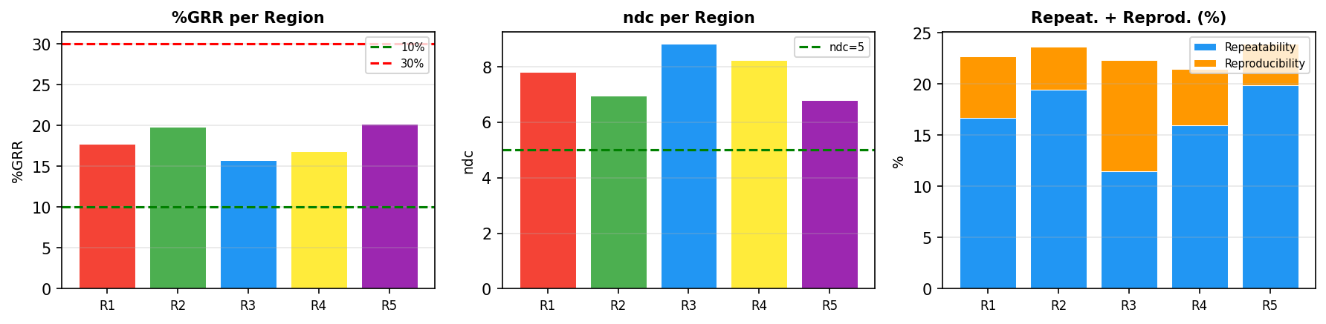
PLM Pixel Analysis - Stitched - Die (33,33)
Region | Position | Size | %GRR | ndc | Repeat.% | Reprod.% | Result
R1 | (129,280)->(154,305) | 25x25 | 17.7% | 7.8 | 16.7% | 6.0% | ACCEPTABLE
R2 | (218,336)->(243,361) | 25x25 | 19.9% | 7.0 | 19.4% | 4.2% | ACCEPTABLE
R3 | (320,395)->(345,420) | 25x25 | 15.8% | 8.8 | 11.4% | 10.9% | ACCEPTABLE
R4 | (194,436)->(219,461) | 25x25 | 16.9% | 8.2 | 15.9% | 5.5% | ACCEPTABLE
R5 | (88,384)->(113,409) | 25x25 | 20.3% | 6.8 | 19.9% | 4.0% | ACCEPTABLE
Die (33, 33)
PLM Type: Stitched
Regions: 5
Files/Trials: 3
Pixels/Region: 625
Best: R3 - %GRR=15.8%
Worst: R5 - %GRR=20.3%

Slide 19
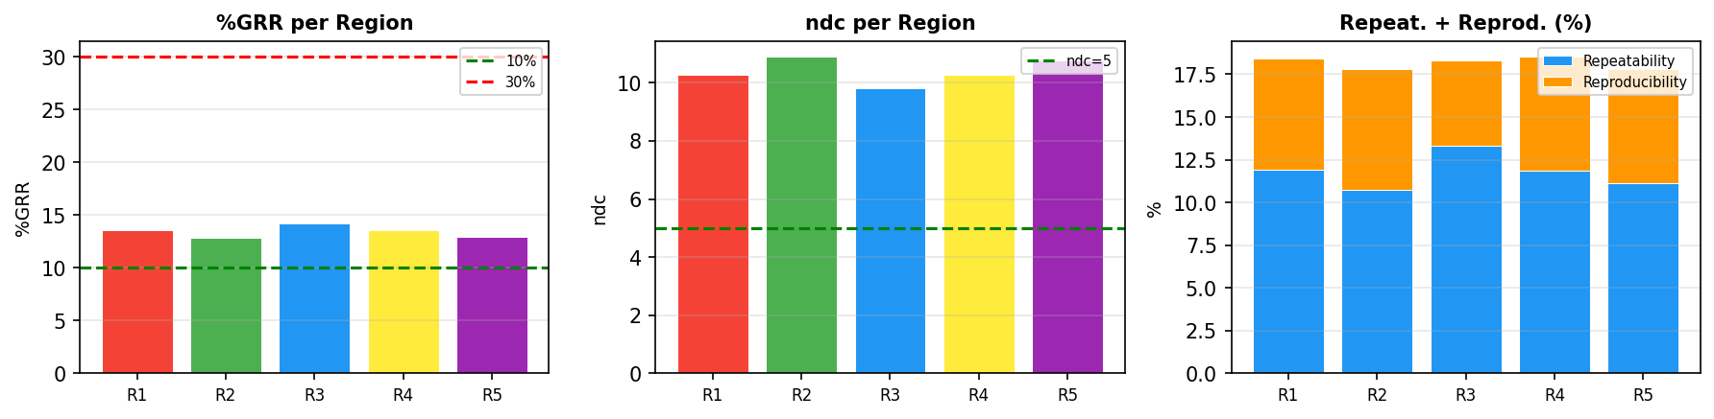
PLM Pixel Analysis - Stitched - Die (35,44)
Region | Position | Size | %GRR | ndc | Repeat.% | Reprod.% | Result
R1 | (129,280)->(154,305) | 25x25 | 13.6% | 10.3 | 11.9% | 6.5% | ACCEPTABLE
R2 | (218,336)->(243,361) | 25x25 | 12.8% | 10.9 | 10.7% | 7.1% | ACCEPTABLE
R3 | (320,395)->(345,420) | 25x25 | 14.2% | 9.8 | 13.3% | 5.0% | ACCEPTABLE
R4 | (194,436)->(219,461) | 25x25 | 13.6% | 10.3 | 11.8% | 6.7% | ACCEPTABLE
R5 | (88,384)->(113,409) | 25x25 | 13.0% | 10.8 | 11.2% | 6.6% | ACCEPTABLE
Die (35, 44)
PLM Type: Stitched
Regions: 5
Files/Trials: 3
Pixels/Region: 625
Best: R2 - %GRR=12.8%
Worst: R3 - %GRR=14.2%

Slide 20
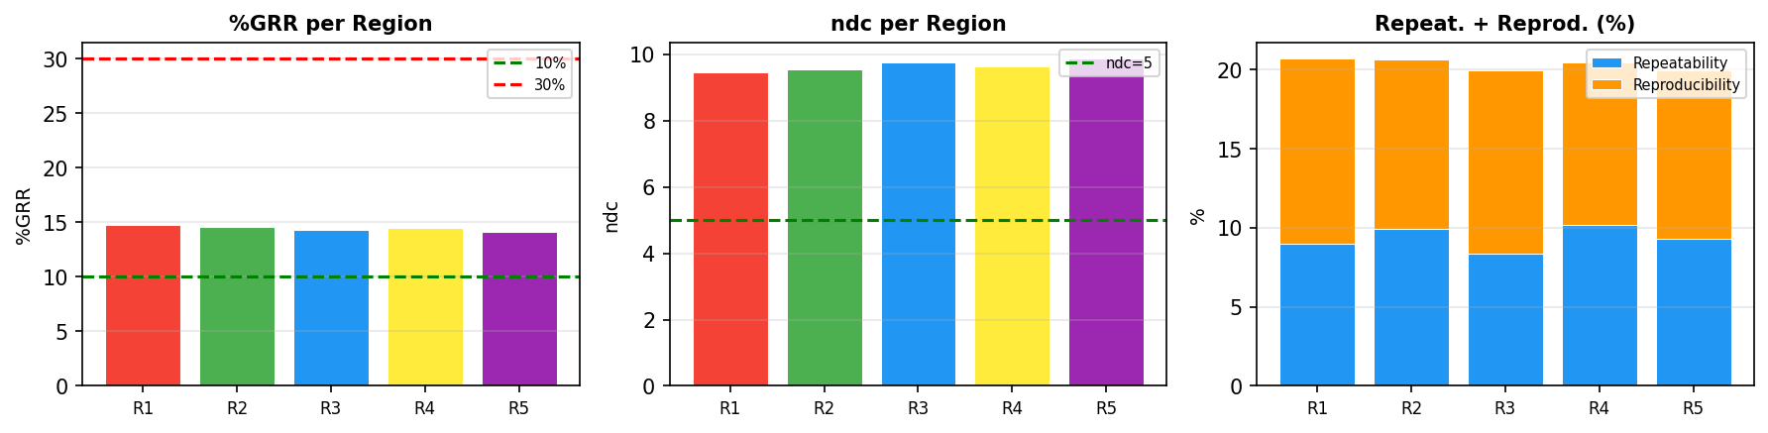
PLM Pixel Analysis - Stitched - Die (39,49)
Region | Position | Size | %GRR | ndc | Repeat.% | Reprod.% | Result
R1 | (129,280)->(154,305) | 25x25 | 14.8% | 9.5 | 9.0% | 11.7% | ACCEPTABLE
R2 | (218,336)->(243,361) | 25x25 | 14.6% | 9.5 | 9.9% | 10.7% | ACCEPTABLE
R3 | (320,395)->(345,420) | 25x25 | 14.3% | 9.8 | 8.4% | 11.6% | ACCEPTABLE
R4 | (194,436)->(219,461) | 25x25 | 14.5% | 9.6 | 10.2% | 10.3% | ACCEPTABLE
R5 | (88,384)->(113,409) | 25x25 | 14.2% | 9.9 | 9.3% | 10.6% | ACCEPTABLE
Die (39, 49)
PLM Type: Stitched
Regions: 5
Files/Trials: 3
Pixels/Region: 625
Best: R5 - %GRR=14.2%
Worst: R1 - %GRR=14.8%

Slide 21
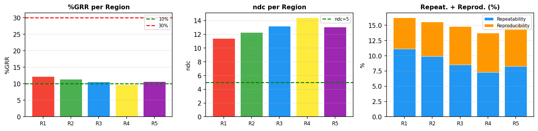
PLM Pixel Analysis - Stitched - Die (44,44)
Region | Position | Size | %GRR | ndc | Repeat.% | Reprod.% | Result
R1 | (129,280)->(154,305) | 25x25 | 12.2% | 11.4 | 11.1% | 5.1% | ACCEPTABLE
R2 | (218,336)->(243,361) | 25x25 | 11.4% | 12.3 | 9.9% | 5.6% | ACCEPTABLE
R3 | (320,395)->(345,420) | 25x25 | 10.6% | 13.2 | 8.5% | 6.3% | ACCEPTABLE
R4 | (194,436)->(219,461) | 25x25 | 9.7% | 14.4 | 7.3% | 6.4% | EXCELLENT
R5 | (88,384)->(113,409) | 25x25 | 10.7% | 13.1 | 8.3% | 6.8% | ACCEPTABLE
Die (44, 44)
PLM Type: Stitched
Regions: 5
Files/Trials: 3
Pixels/Region: 625
Best: R4 - %GRR=9.7%
Worst: R1 - %GRR=12.2%

Slide 22
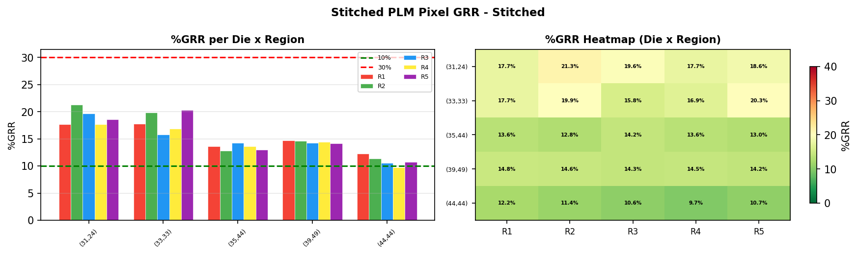
PLM Pixel Analysis - Stitched Overview - Stitched
Die | R1 %GRR | R2 %GRR | R3 %GRR | R4 %GRR | R5 %GRR | Avg %GRR
(31,24) | 17.7% | 21.3% | 19.6% | 17.7% | 18.6% | 19.0%
(33,33) | 17.7% | 19.9% | 15.8% | 16.9% | 20.3% | 18.1%
(35,44) | 13.6% | 12.8% | 14.2% | 13.6% | 13.0% | 13.4%
(39,49) | 14.8% | 14.6% | 14.3% | 14.5% | 14.2% | 14.5%
(44,44) | 12.2% | 11.4% | 10.6% | 9.7% | 10.7% | 10.9%
Stitched Die Comparison
PLM Type: Stitched
Total Dies: 5
Regions per Die: 5
Files/Trials: 3
Best: Die(44,44) R4 - 9.7%
Worst: Die(31,24) R2 - 21.3%

Slide 23
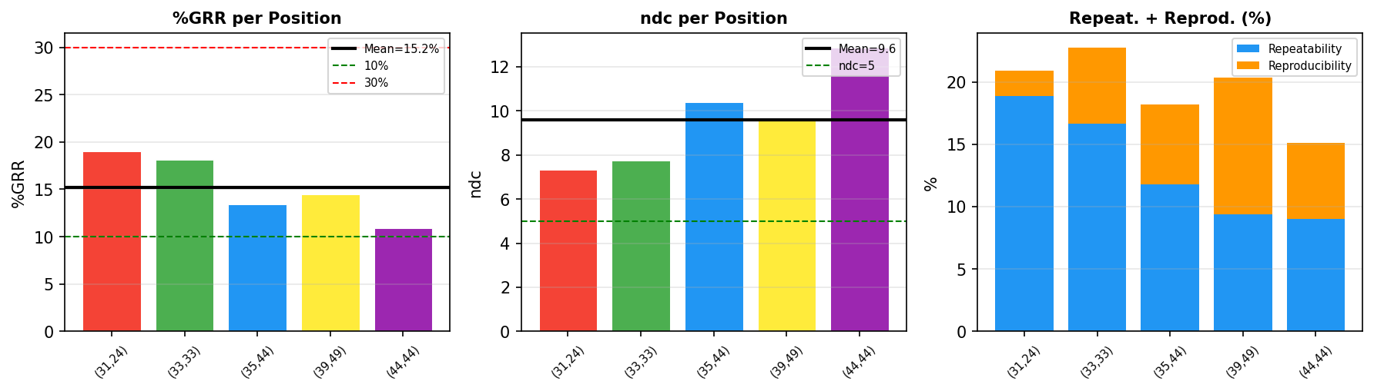
PLM-GAGE Summary (Mean): Stitched
Assessment: ACCEPTABLE
Mean %GRR: 15.19%
Mean ndc: 9.6
Mean Repeatability: 13.14%
Mean Reproducibility: 6.32%
Positions analyzed: 5

